Slide 1

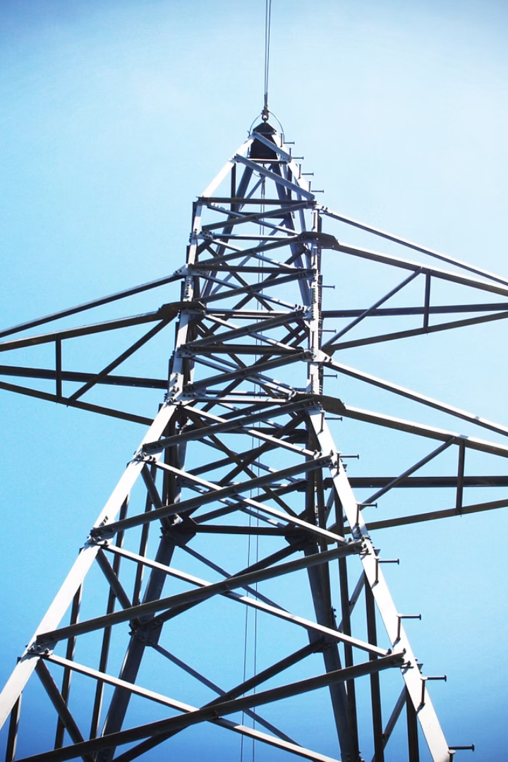

Electrical Network Modelling of NIT KKR using OpenDSS and Real-Time Smart Meter Analysis
This project models and analyses the electrical distribution network of the National Institute of Technology Kurukshetra (NIT KKR) campus using OpenDSS and real-time smart meter data analysis.
Github Link : OpenDSS Smart Meter Analysis
Guided by : Dr. Pradeep Kumar
Made by : Shivansh Kumar Jha
12114138
EE-B07

Slide 2
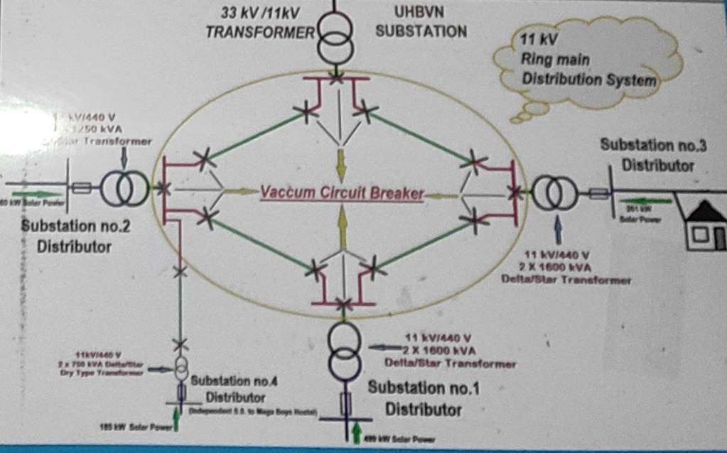
NIT KKR Ring Main Distribution System and Components
Main Power Source
Substations & Transformers
The 11 kV, 3-phase AC supply at NITK_MainBus acts as the sole incoming power source, ensuring stable supply to the campus network.
Four substations with dual transformers provide redundancy and load sharing. Transformers step down voltage from 11 kV to 0.44 kV for campus loads.
Distribution Lines & Loads
Resistive-only cables connect substations, simulating underground or overhead lines. Balanced three-phase loads include hostels, labs, canteen, gym, and admin blocks with diverse power demands.

Slide 3
OpenDSS Code Architecture and Implementation
1
Circuit Initialization
Defines base parameters and main source with 11 kV, 3-phase balanced system at NITK_MainBus.
2
Substations & Transformers
Configures HV-LV transformers with 5.75% impedance and wye-wye connections for realistic voltage drop and grounding.
3
Lines & Loads
Connects substations with resistive lines and attaches diverse campus loads to LV buses, reflecting real consumption patterns.
4
Simulation Commands
Runs power flow simulations with tight tolerance, generating CSV outputs for voltage, current, power, and losses for post-processing.

Slide 4
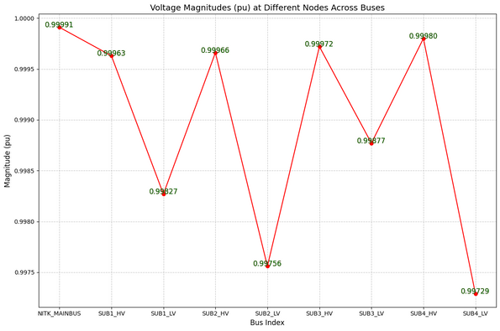
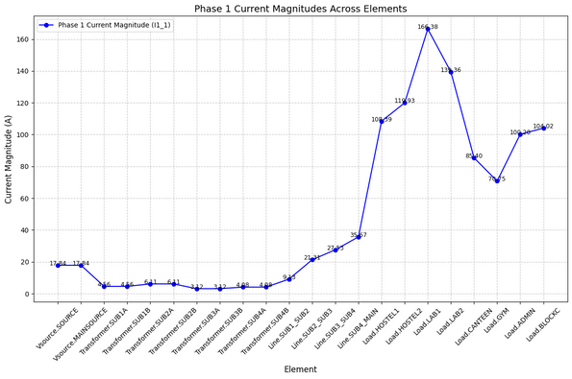
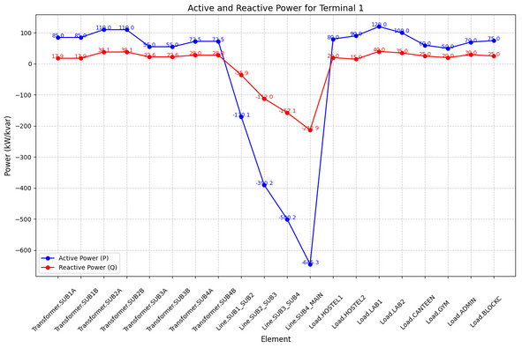
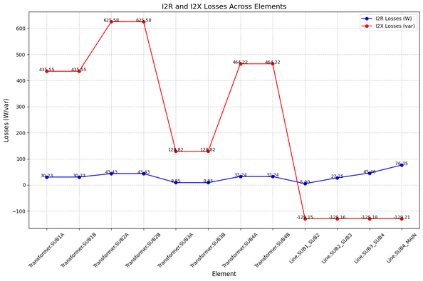
Analysis of OpenDSS Outputs Using Python
1
Voltage Analysis
All buses maintain voltage close to 1.0 pu, indicating stable voltage regulation. NITK_MainBus serves as the near-ideal reference bus.
2
Current Distribution
Currents increase progressively through line segments, peaking at SUB4 to Main (106.99A). Hostel2, Lab1, and Hostel1 are the highest consumers.
3
Power Flow
Transformers show minimal active power losses. Lab1 and BlockC have high active to reactive power ratios, typical for mixed load types.
4
Loss Analysis
Reactive losses dominate transformer losses, highlighting the need for capacitor banks to improve power factor and reduce losses.

Slide 5
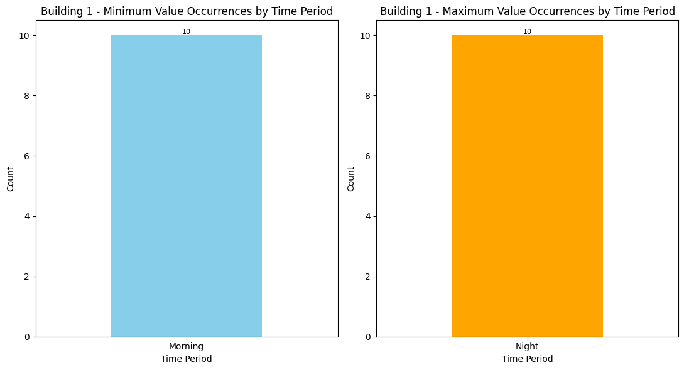
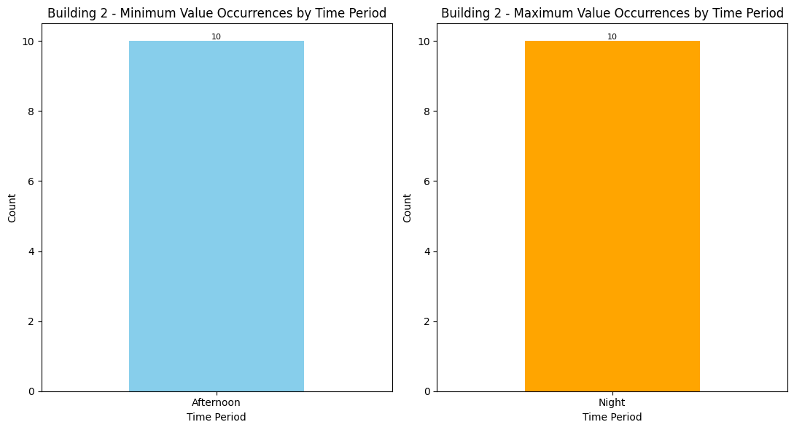
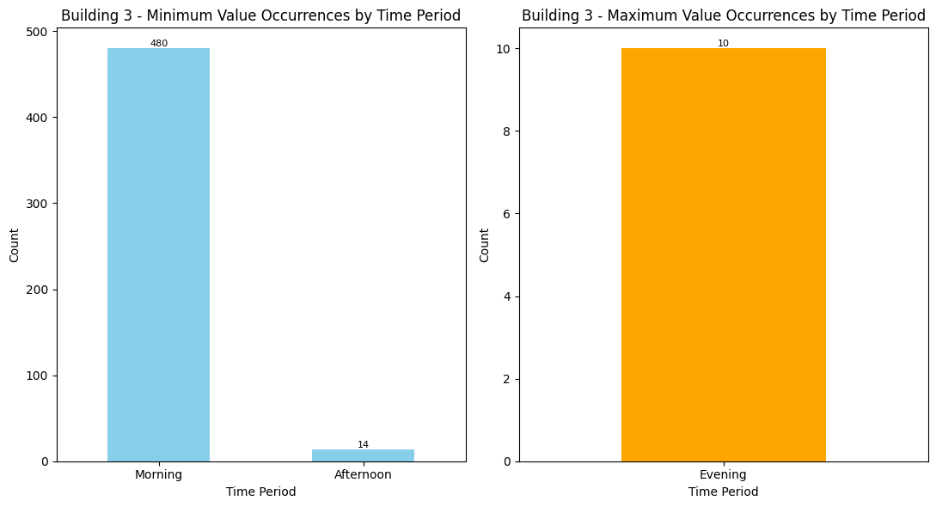

Smart Meter Data Aggregation and Cleaning Pipeline

Slide 6
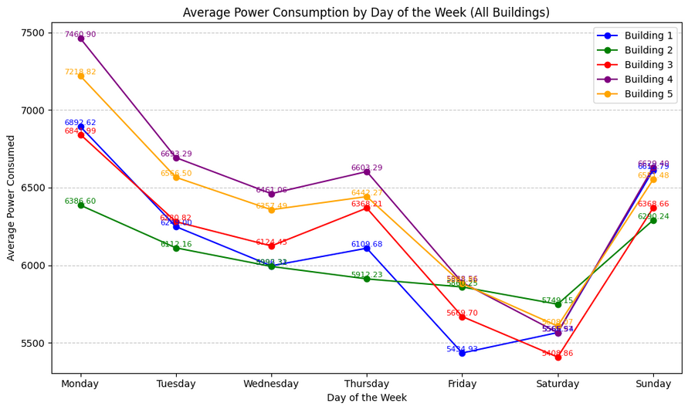
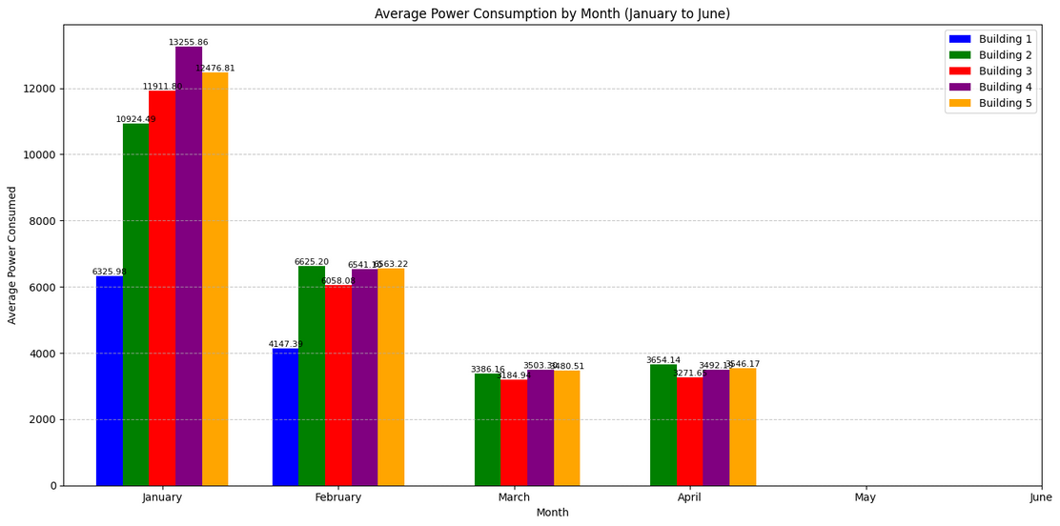
Energy Consumption Visualizations and Insights
Time Period Analysis
Day-Wise Trends
Minimum consumption typically occurs in the morning, while maximum consumption peaks at midnight, reflecting building usage patterns.
Higher usage on Mondays suggests post-weekend ramp-up, with lower consumption on weekends indicating reduced activity.
Month-Wise Patterns
Winter months show higher energy use due to heating, while missing data in May and June affects seasonal analysis accuracy.

Slide 7
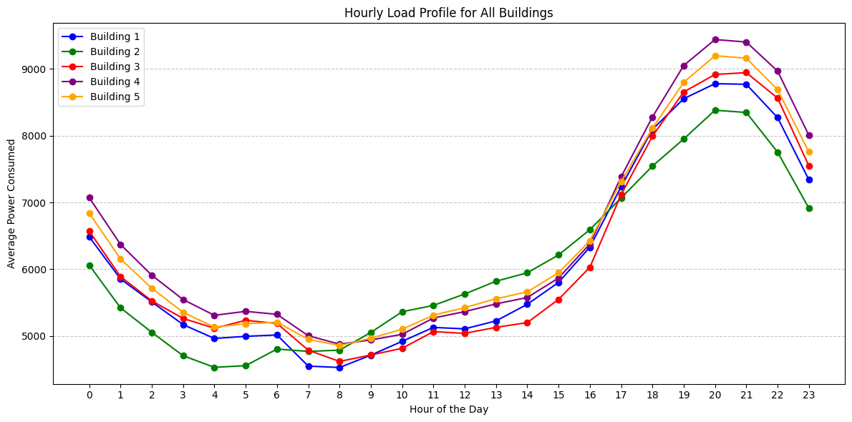
Hourly Load Profiles and Building Demand Factors
Hourly Load Profile
Demand and Load Factors
Energy consumption peaks in the evening (18:00–20:00) and is lowest in early morning hours (2:00–5:00), reflecting occupant activity.
Demand factor ranges from 0.32 to 0.71, indicating
varying peak utilisation across buildings.
Load factors are low (0.15–0.19), showing inconsistent
energy use with short-duration peaks.
The canteen has the highest demand factor.

Slide 8


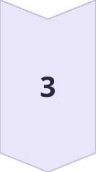
Load Forecasting, Improvements, and Future Perspectives
Load Forecasting
An ARIMA model predicts daily power consumption with reasonable accuracy, aiding in energy planning and management.
Improvements
Future work includes integrating reactive power measurements, conducting load surveys, and installing smart meters for precise data.
Future Perspectives
Integration of renewable energy sources, real-time IoT monitoring, SCADA systems, and machine learning for intelligent, resilient campus grids.

Slide 9
Conclusion
This project showcases effective modeling and simulation of NIT Kurukshetra's electrical distribution grid with OpenDSS, aided by real-time smart meter feeds and Python-powered visualizations. It assesses voltage profiles, current flow, power loss, and load dynamics with high accuracy, offering an adjustable framework to suit different working conditions. Significant contributions are made in the form of hourly load profiling, forecasting using ARIMA, and building-wise analytics, emphasizing the role of data-centric methods in energy planning for campus. The work paves the way for the integration of future renewables, analysis of reactive power, and real-time monitoring via IoT and SCADA, leading to smart and sustainable energy management.

Slide 10

Thank You !

